Slide 1

ALGORITHMS LAB (CS-2271) ASSIGNMENT - 1
ARITRA BANDYOPADHYAY (2021CSB107)
BIPRADEEP BERA (2021CSB109)

Slide 2
1-A: CONSTRUCT LARGE DATASETS TAKING RANDOM NUMBERS FROM UNIFORM DISTRIBUTION (UD)

Slide 3
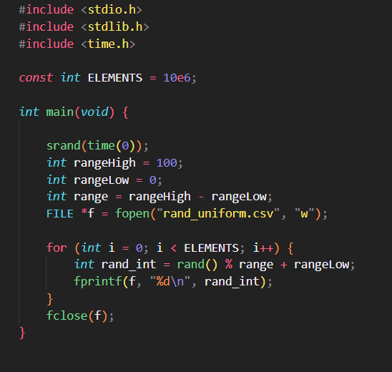
APPROACH AND CODE IN C
The rand() function in C was used to generate 1 million pseudorandom numbers
“seconds” value of the PC clock was used as the seed from the PRNG
Dataset was saved as a .csv file

Slide 4
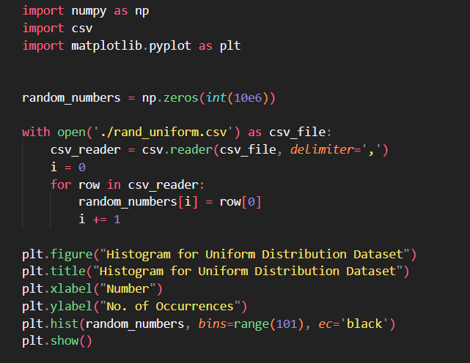
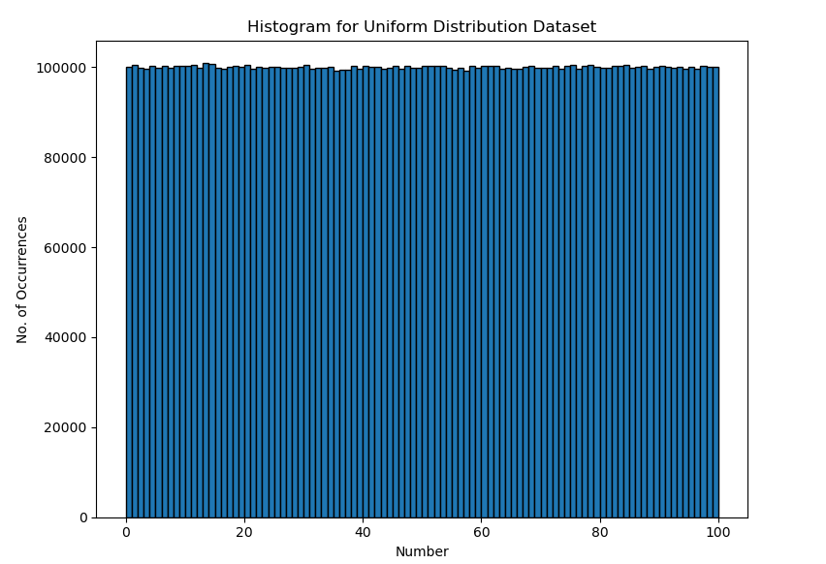
GRAPH OF UD DATASET, PLOTTER CODE

Slide 5
1-B: CONSTRUCT LARGE DATASETS TAKING RANDOM NUMBERS FROM NORMAL DISTRIBUTION (ND)

Slide 6
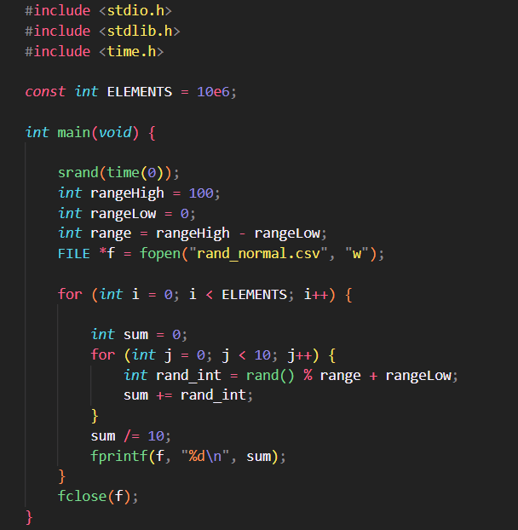
APPROACH AND CODE IN C
“seconds” value of the PC clock was used as the seed from the PRNG
To generate a single number from normal distribution, 10 random numbers were taken and averaged
1 million such averages were done to generate ND dataset
Dataset was saved as a .csv file

Slide 7
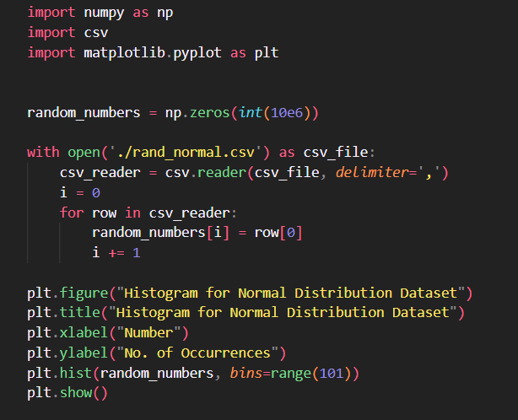
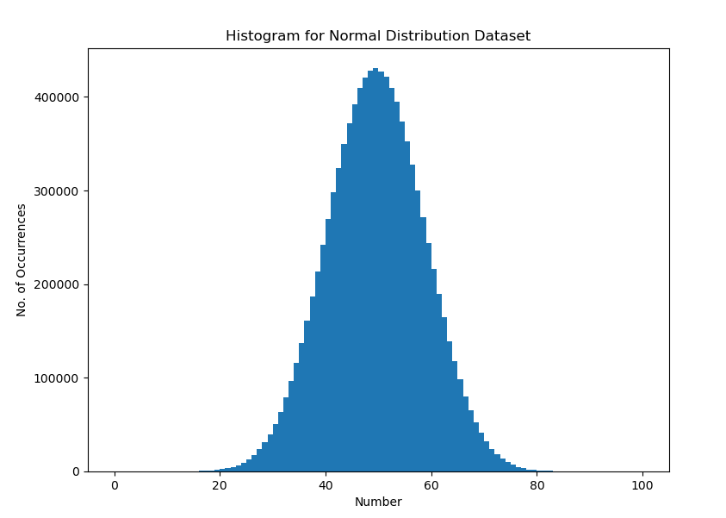
GRAPH OF ND DATASET, PLOTTER CODE

Slide 8
2-A: Implement Merge Sort (MS) and check for correctness

Slide 9
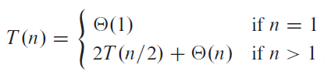
THE MERGE SORT ALGORITHM
Merge sort is a Divide-and-Conquer Algorithm that works as follows:
Divide: Compute middle of the array, takes constant time O(1)
Conquer: Recursively solve two subproblems, each of size 2, which contributes 2T(n/2) to the running time
Combine: Merging the two subarrays, takes O(n)

Slide 10
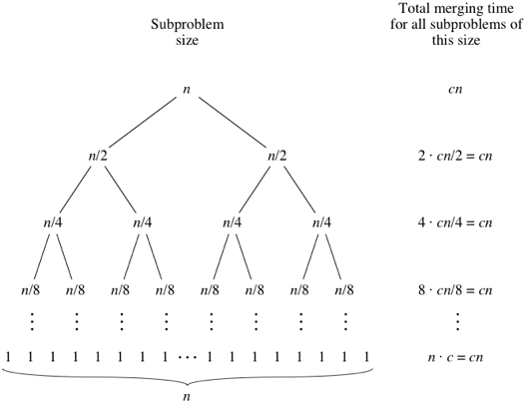
RECURSION TREE FOR MERGE SORT
At every level of recursion tree, cn amount of work needs to be done
The height of the recursion tree is (lgn)
So the work that needs to be done is O(nlgn) for sorting the whole array of size n

Slide 11
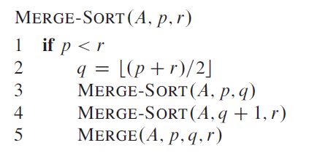
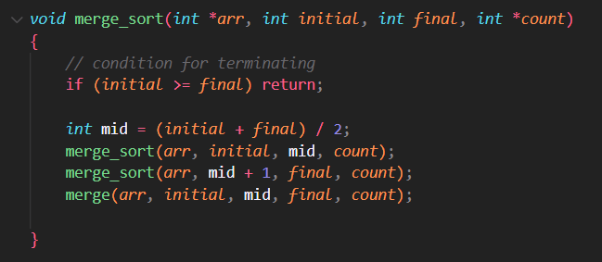
THE MERGE SORT ALGORITHM
The pseudo-code for the Merge Sort algorithm and code in C is shown here
The function divides an array into two subarrays
Recursive call is then carried out on both subarrays [2T(n/2)]
The merge method merges the sorted subarrays together O(n)

Slide 12
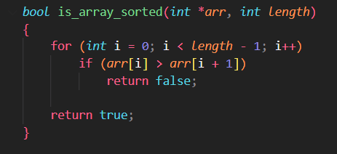
CHECKING FOR CORRECTNESS
The function compares current element with next
Returns false if any current element is greater than next
Returns true otherwise

Slide 13
2-B: Implement Quick Sort (QS) and check for correctness

Slide 14
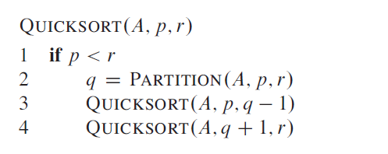
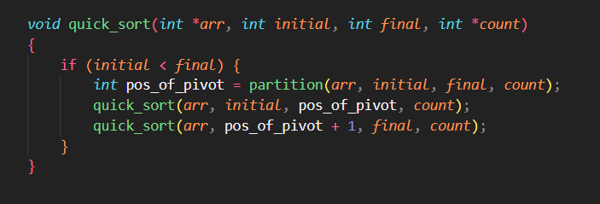
THE QUICK SORT ALGORITHM
Quicksort is a Divide-and-Conquer algorithm that works as follows:
Divide: Partition (rearrange) the array into two (possibly empty) arrays
Conquer: Sort the two subarrays by recursive calls to quicksort
Merge: Because the subarrays are already sorted, no work is needed to combine them: the entire array is now sorted

Slide 15
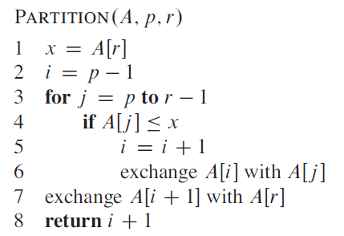
THE QUICK SORT ALGORITHM
The key process in Quicksort is partition(). Target of partitions is, given an array and an element 𝑥 of array as pivot, put 𝑥 at its correct position in sorted array and put all smaller elements (smaller than 𝑥) before 𝑥, and put all greater elements (greater than 𝑥) after 𝑥. All this should be done in linear time.

Slide 16
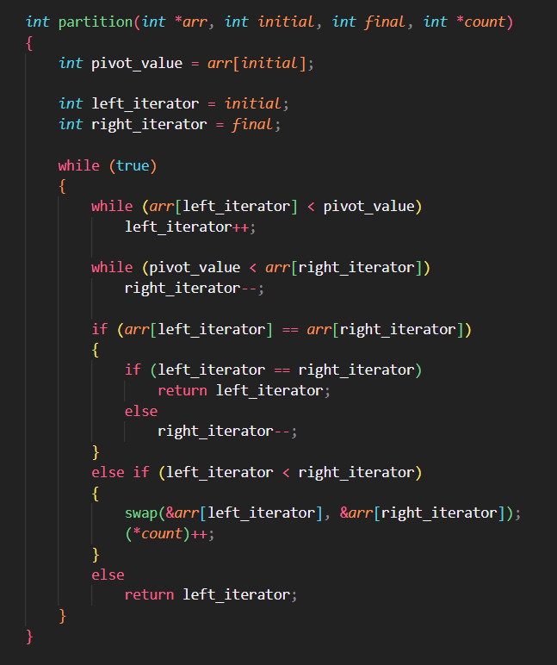
PARTITIONING
The Hoare partitioning scheme is used here.
The pivot is always set to the first element of the array in this scheme.

Slide 17
CHECKING FOR CORRECTNESS
The function compares current element with next
Returns false if any current element is greater than next
Returns true otherwise

Slide 18
3. Count the operations performed, like comparisons and swaps with problem size increasing in powers of 2, for both MS and QS with both UD and ND as input data

Slide 19

COUNTING OPERATIONS
We varied the array size (n) in powers of 2, recording array sizes from 2¹ to 2¹⁹
Operations like swaps, comparisons were counted. Also we counted writing to memory operation too as it is also costly
We plotted $\frac{comparisons}{n×\log_{2}{n}}$ vs $\log_{2}{n}$ and $\frac{time}{n×\log_{2}{n}}$ vs $\log_{2}{n}$ for both MS and QS
For QS, we permuted the array before sending it to QS so that we have 100 QS calls, each for a shuffled permutation of the array

Slide 20
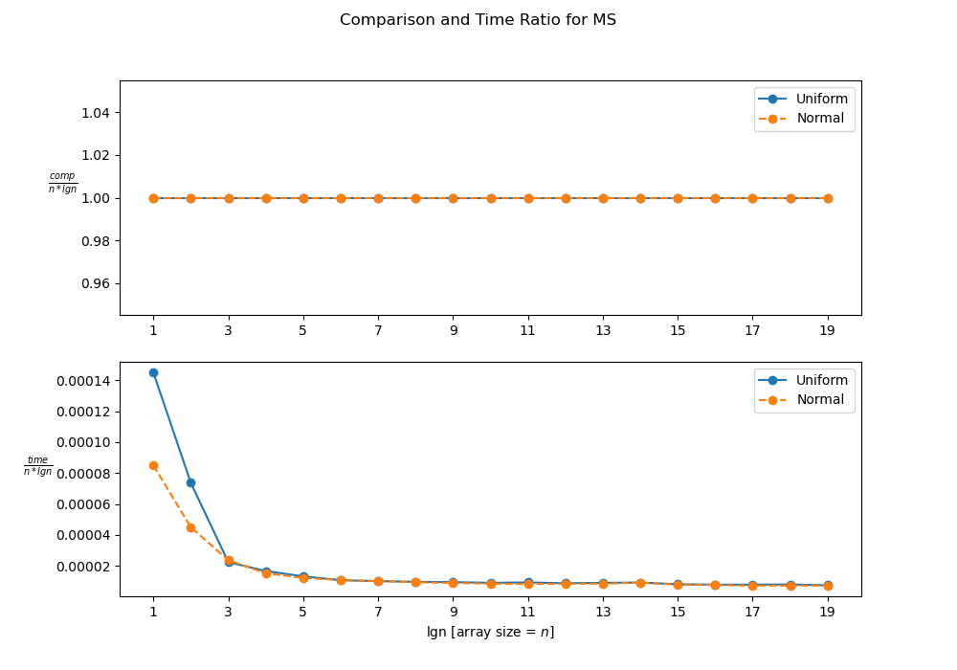
COUNTING OPERATIONS (MS)

Slide 21

OBSERVATIONS FOR MS
$\frac{comparisons}{n×\log_{2}{n}}$ remains constant for all array sizes for both UD and ND
$\frac{time}{n×\log_{2}{n}}$ also converges to a constant for arrays of appreciable sizes for both UD and ND data
This shows the deterministic nature of Merge Sort where the number of operations is of the order O(nlgn)

Slide 22
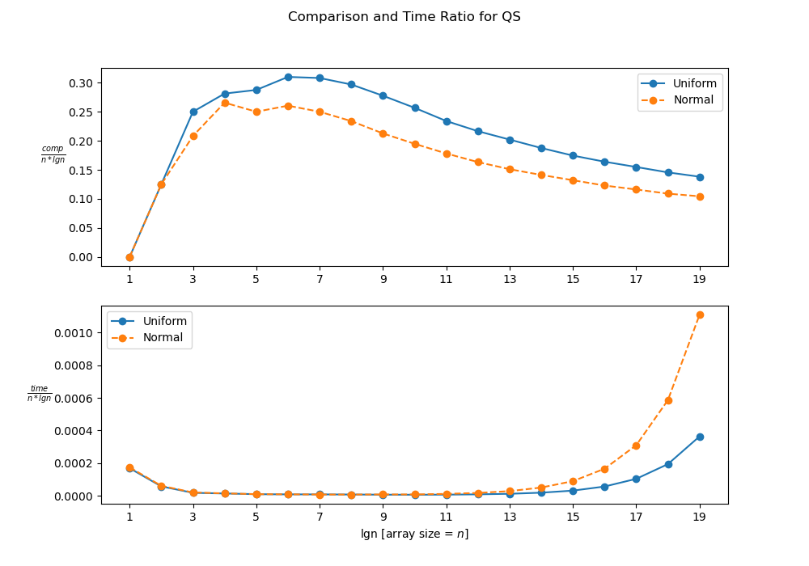
COUNTING OPERATIONS (QS)

Slide 23

OBSERVATIONS FOR QS
$\frac{comparisons}{n×\log_{2}{n}}$ ratio converges to a constant for higher array sizes
$\frac{time}{n×\log_{2}{n}}$ ratio is constant but diverges for very large array sizes
Operations done are lower for ND than UD. This might be because for the ND dataset the partition algorithm has a larger tendency to partition an element that is towards the middle in terms of value (frequency of median values is more in ND)

Slide 24
4. Experiment with randomized QS (RQS) with both UD and ND as input data to arrive at the average complexity (count of operations performed) with both input datasets.

Slide 25
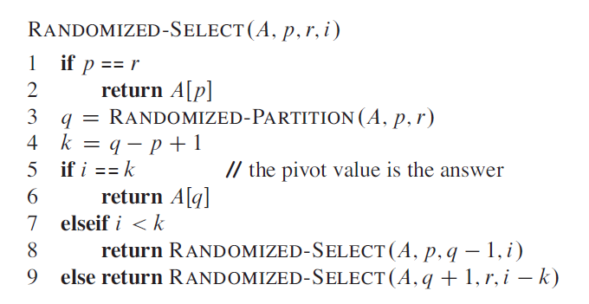
RANDOMIZED QS ALGORITHM
Randomized Quicksort is a sorting algorithm that uses a randomized partitioning scheme to achieve an average-case time complexity of O(n log n) when sorting a sequence of n elements.

Slide 26

COUNTING OPERATIONS
We varied the array size (n) in powers of 2, recording array sizes from 2¹ to 2¹⁹
Operations like swaps, comparisons were counted. Also we counted writing to memory operation too as it is also costly
We plotted $\frac{comparisons}{n×\log_{2}{n}}$ vs $\log_{2}{n}$ and $\frac{time}{n×\log_{2}{n}}$ vs $\log_{2}{n}$ for Randomized QS
We also permuted the array before sending it to QS so that we have 100 RQS calls, each for a shuffled permutation of the array

Slide 27
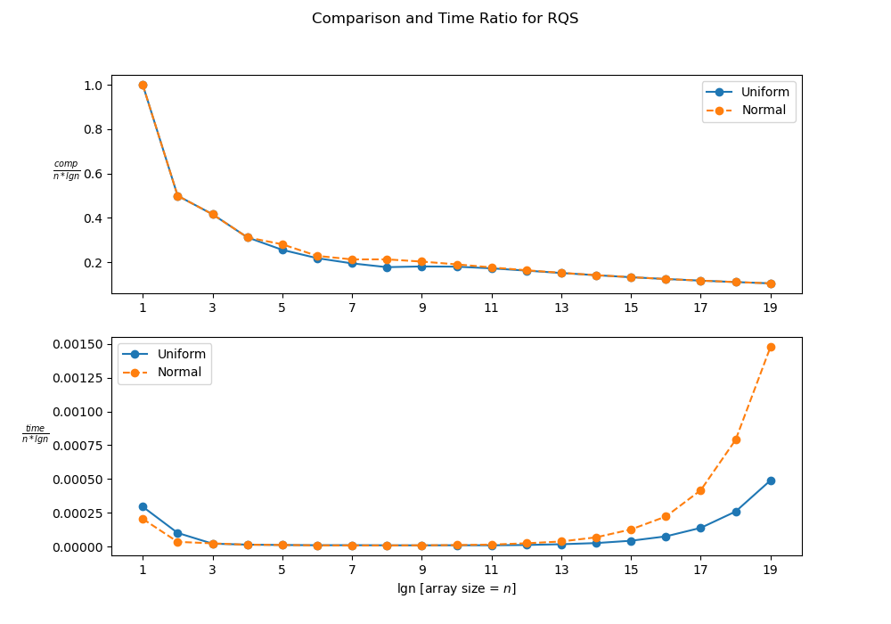
COUNTING OPERATIONS (RQS)

Slide 28

OBSERVATIONS FOR QS
$\frac{comparisons}{n×\log_{2}{n}}$ ratio converges to a faster than QS for both UD and ND
$\frac{time}{n×\log_{2}{n}}$ ratio is constant but diverges for very large array sizes
On average, the performance for Randomized QS is much better than QS implemented with Hoare partition
This is because randomized partition tends to make the RQS O(n lgn) when averaged over a number of runs

Slide 29
5. Now normalize both the datasets in the range from 0 to 1 and implement bucket sort (BS) algorithm and check for correctness

Slide 30
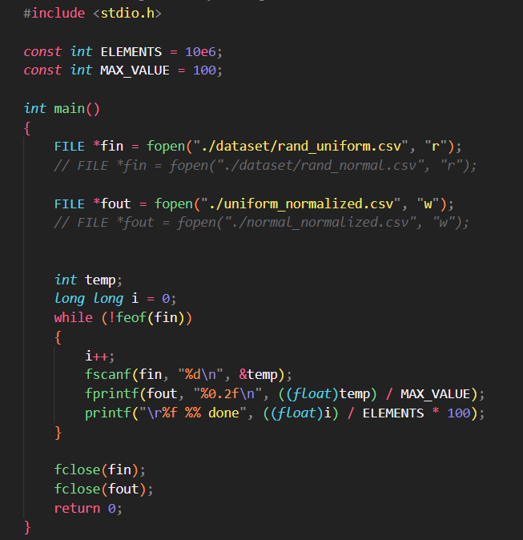
NORMALIZATION OF DATASETS
Both the UD and ND datasets were normalized by dividing with the range of each value (range = 100-0 = 100)

Slide 31
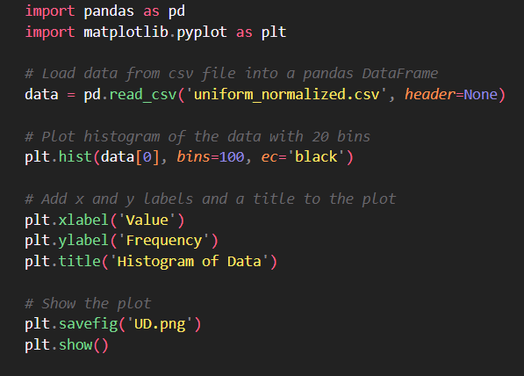
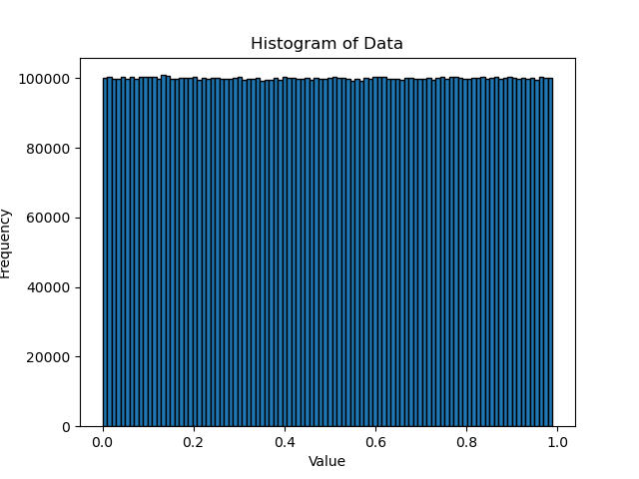
GRAPH OF UD DATASET (NORMALIZED)

Slide 32
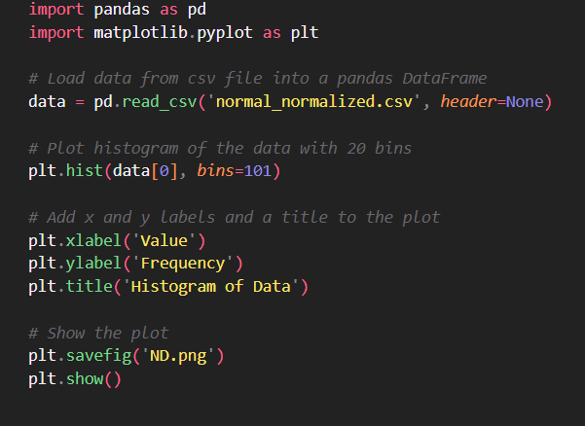
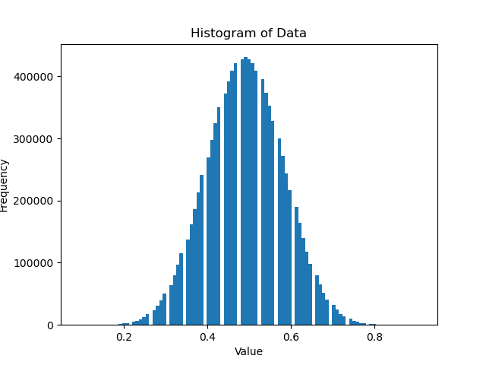
GRAPH OF UD DATASET (NORMALIZED)

Slide 33
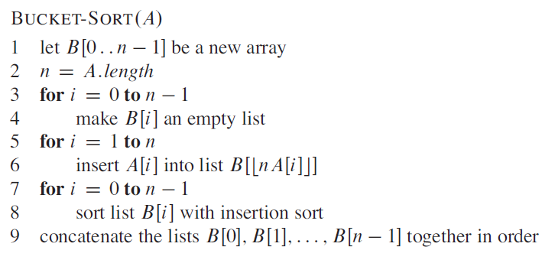
BUCKET SORT ALGORITHM
Bucket sort, or bin sort is a sorting algorithm that works by partitioning an array into a number of buckets, each of which is then sorted individually using another sorting algorithm (like insertion sort)

Slide 34
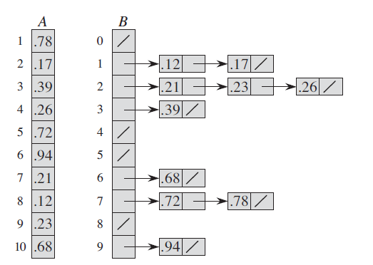
BUCKET SORT ALGORITHM
Bucket sort is most effective when the input values are uniformly distributed and the range of input values is not much larger than the number of elements to be sorted.
Bucket sort's time complexity is O(n+k) where n is the number of elements to be sorted and k is the number of buckets used. If k is much larger than n, performance may decrease due to excessive overhead.

Slide 35
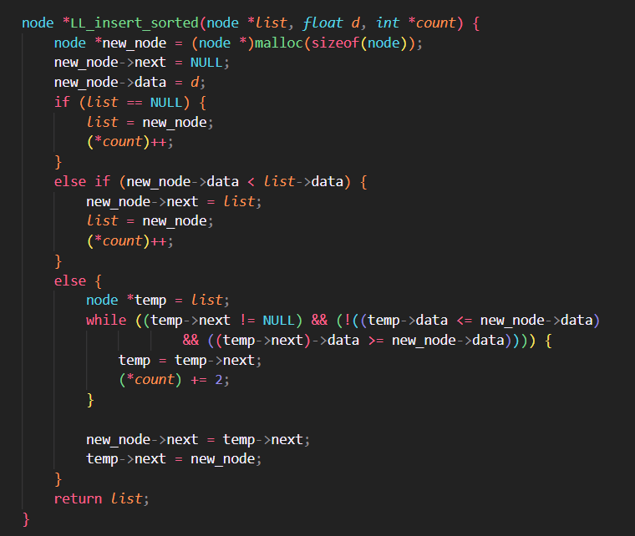
BUCKET SORT IMPLEMENTATION
Insertion sort algorithm has been used to sort the LL
The shown function inserts a node into its appropriate position in a linked list

Slide 36
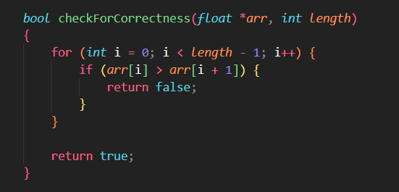
CHECKING FOR CORRECTNESS
The function compares current element with next
Returns false if any current element is greater than next
Returns true otherwise

Slide 37
6. Experiment with BS to arrive at its average complexity for both UD and ND data sets and infer

Slide 38
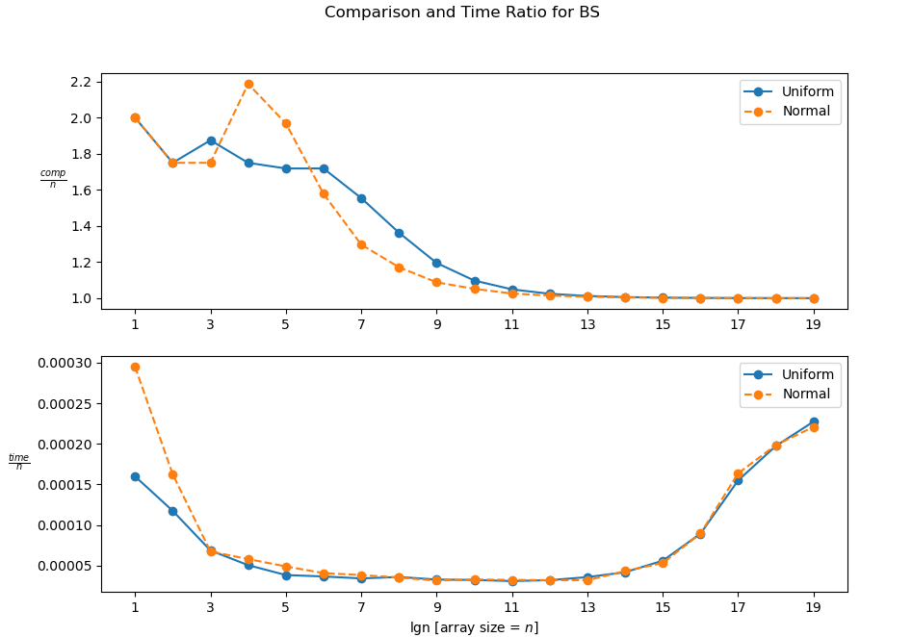
COUNTING OPERATIONS (BS)

Slide 39

OBSERVATIONS FOR BS
$\frac{comparisons}{n}$ ratio converges to a constant for both UD and ND datasets
From this, we can infer that Bucket Sort is a linear time sorting algorithm, on an average

Slide 40
7. Implement the worst case linear median selection algorithm by taking the median of medians (MoM) as the pivotal element and check for correctness.

Slide 41
MEDIAN-OF-MEDIANS
The Median of Medians is an approximate (median) selection algorithm, frequently used to supply a good pivot for an exact selection algorithm, mainly quicksort, that selects the k^{th} largest element of an initially unsorted array.
When this approximate median is used as an improved pivot, the worst-case complexity of quicksort reduces significantly from O(n) to O(n lgn) , which is also the asymptotically optimal worst-case complexity of any sorting algorithm

Slide 42
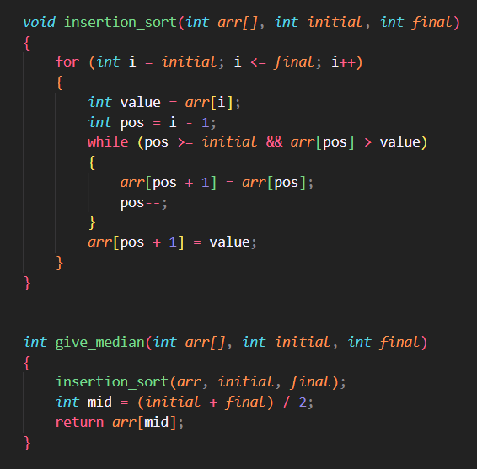
IMPLEMENTATION IN C
give_median returns the median element of a given subarray, by first sorting it using insertion_sort

Slide 43
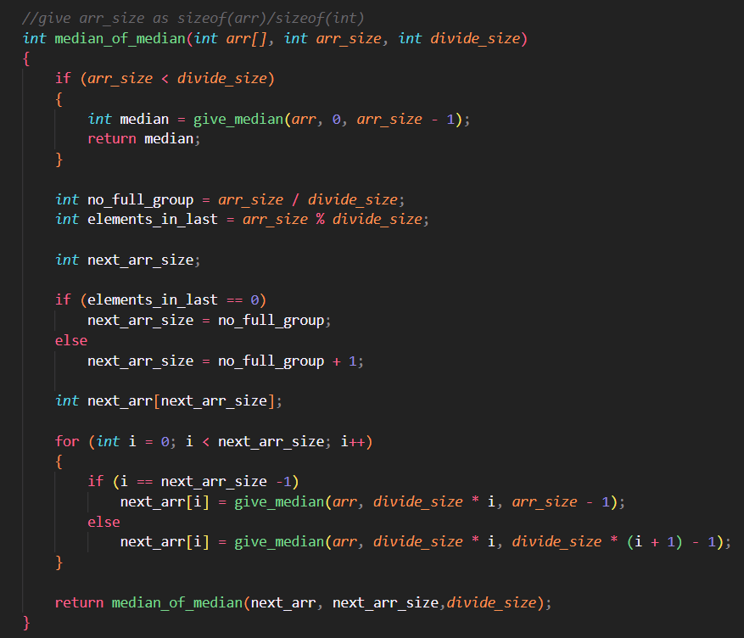
IMPLEMENTATION IN C
median_of_medians recursively partitions an array into subarrays of size divide_size and calculates the median of each subarray using give_median. These medians are collected into a new array and median_of_medians is called on this new array until its size is less than divide_size. Finally, the median of the last subarray is returned.

Slide 44
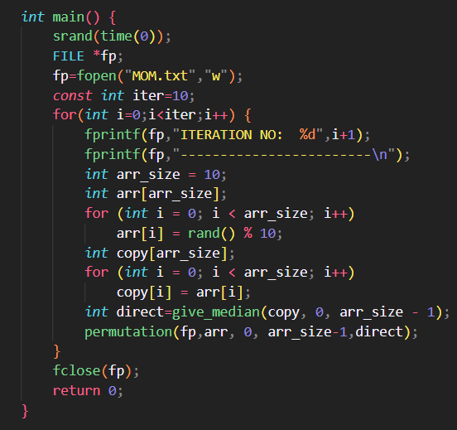
IMPLEMENTATION IN C
In the main function, generate an array of random integers of length arr_size, and make a copy of it.
Compute the direct calculation of the median of the original array using give_median.
Permutation is applied to the array, and the results are written to a file for each iteration. The direct median of a randomly generated array is consistent across permutations. MOM analysis is only compared to the expected result.

Slide 45
8. Take different sizes for each trivial partition (3/5/7 ...) and see how the time taken is changing

Slide 46
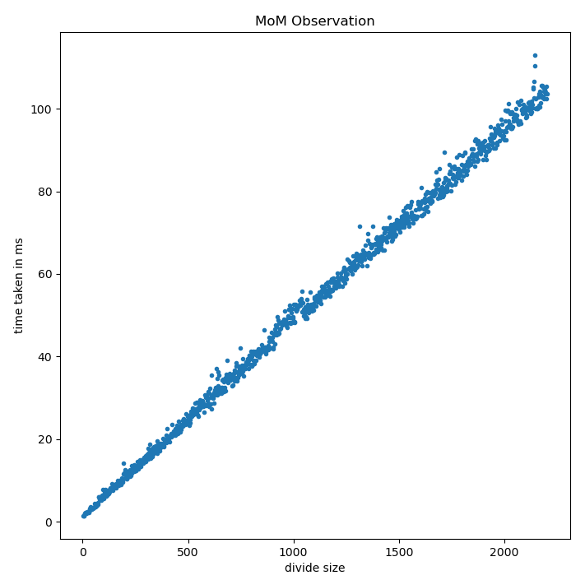
OBSERVATION OF TIME VS DIVIDE SIZE
Median of medians was computed for fixes array size (10000) but varying the divide size every time (from 3, 5, 7, ..., 2203)
Each divide size was run 10 times and avg_time was taken
From the graph, we can observe that time taken varies linearly with divide size

Slide 47
9. Perform experiments by rearranging the elements of the datasets (both UD and ND) and comment on the partition or split obtained using the pivotal element chosen as MoM

Slide 48
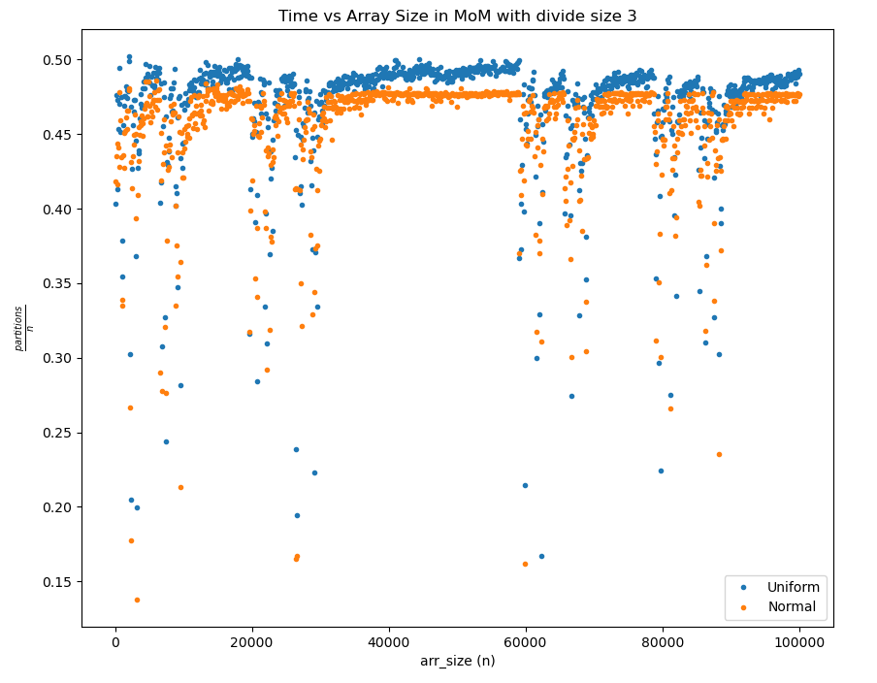
DIVIDE SIZE 3

Slide 49
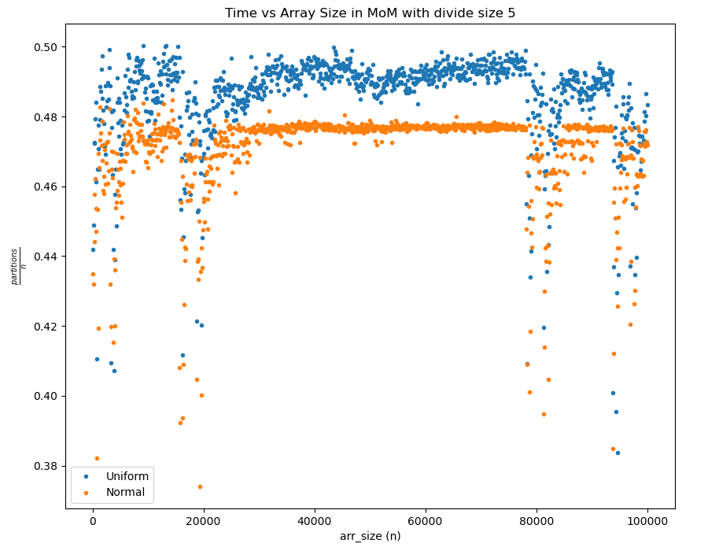
DIVIDE SIZE 5

Slide 50
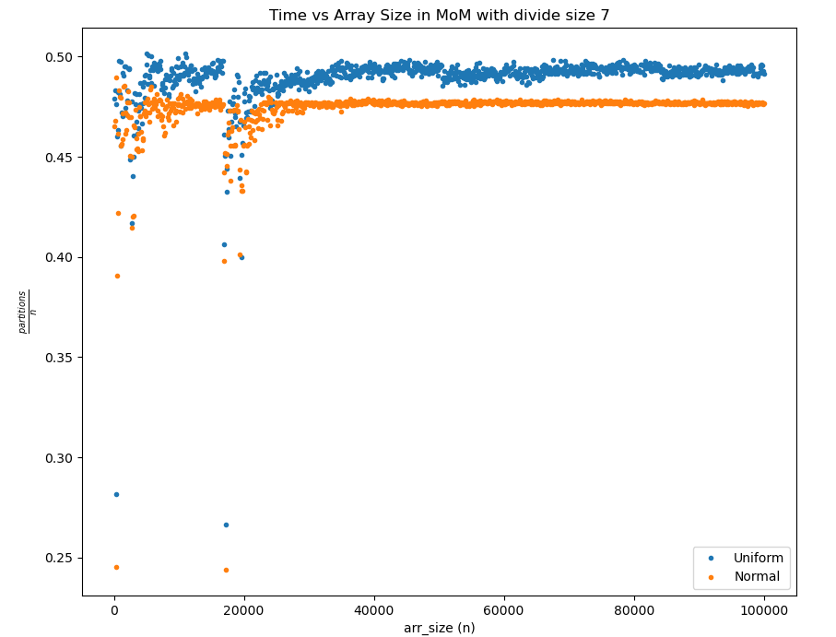
DIVIDE SIZE 7

Slide 51

INFERENCE
$\frac{partition}{arr_size}$ ratio is close to 0.5 for the various partition sizes shown (3/5/7) for both UD and ND dataset
This shows that MoM finds a very good approximate median, thus proving to be a good pivot for the QS algorithm

Slide 52
THANK YOU

